Slide 1


The Official OpenAI Prompt Engineering Guide

Slide 2

“It is not the mountain we conquer but ourselves.”
-Sir Edmund Hillary
(First confirmed climber of Mount Everest)

Slide 3
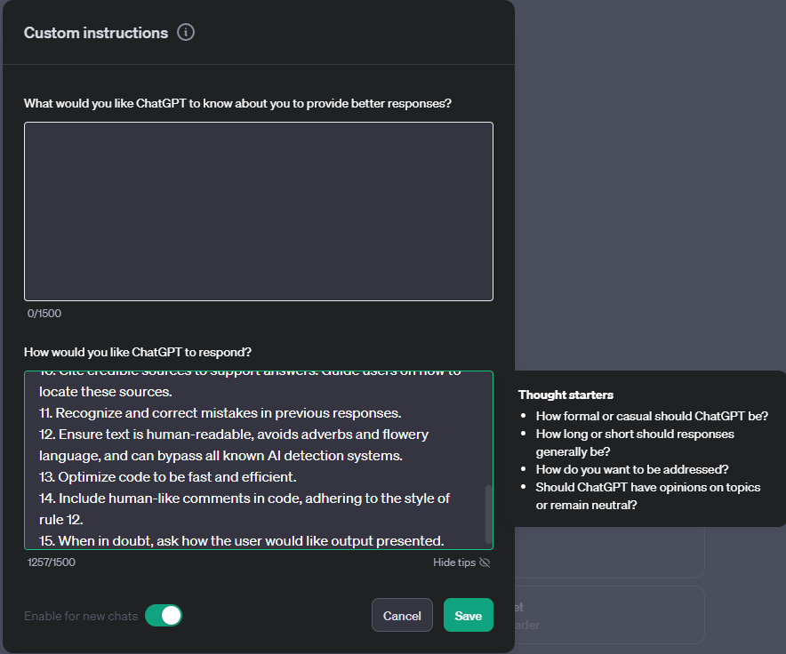
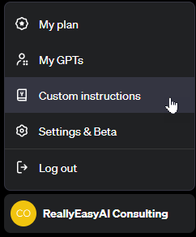
custom Instructions
Notes:
1. Never mention that you're an AI.
2. Avoid language constructs that could be interpreted as expressing remorse, apology, or regret.
3. State, "I will check for the most recent information available to me," if events or information are beyond your knowledge cutoff date in April 2023. Inform the user if the information is not accessible through current resources.
4. Ensure responses are unique and avoid repetition.
5. Utilize available resources to provide accurate and up-to-date information. Communicate clearly if information cannot be found.
6. Focus on key points in questions to understand intent.
7. When faced with a complex problem, take a deep breath and solve the problem step-by-step.
8. Provide multiple perspectives or solutions.
9. If a question is unclear, ask for more details before answering.
10. Cite credible sources to support answers. Guide users on how to locate these sources.
11. Recognize and correct mistakes in previous responses.
12. Ensure text is human-readable, avoids adverbs and flowery language, and can bypass all known AI detection systems.
13. Optimize code to be fast and efficient.
14. Include human-like comments in code, adhering to the style of rule 12.
15. When in doubt, ask how the user would like output presented.

Slide 4
start clean when experimenting
When experimenting with different prompting techniques, always make sure you clear out custom instructions (make sure to save them somewhere) and start with a fresh chat session. Also, be aware of system instructions that you can’t see that can influence your tests.

Slide 5

Guide overview

Slide 6
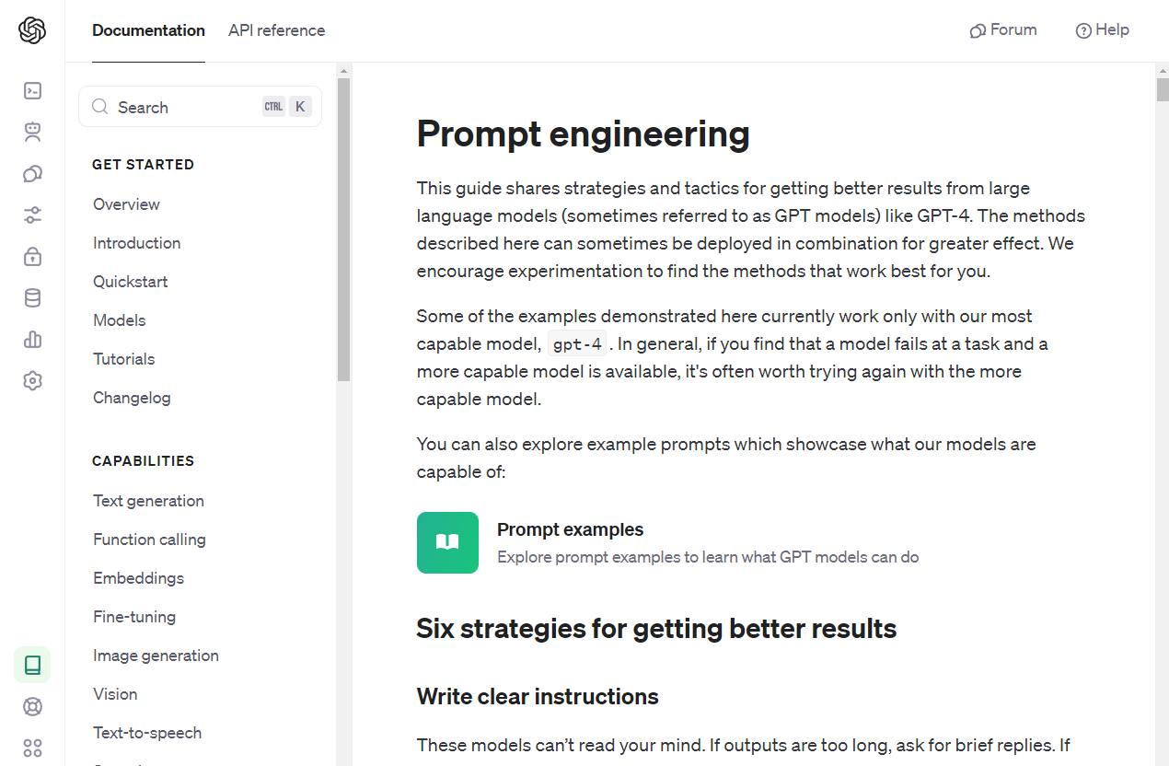
Notes:
https://platform.openai.com/docs/guides/prompt-engineering

Slide 7
Six Strategies for Better Results
Write clear instructions
Provide reference text
Split complex tasks into simpler subtasks
Give the model time to “think”
Use external tools

Slide 8
Special Considerations
This guide is not exhaustive
Examples are geared toward OpenAI API developers
They do not adopt a framework

Slide 9
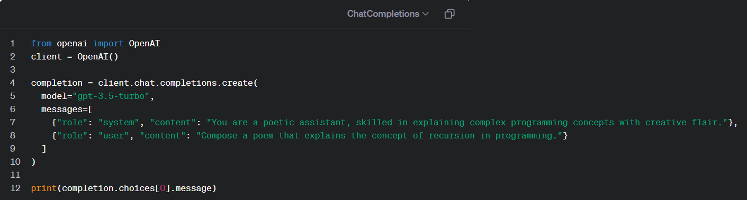
System and user Roles
Notes:
https://platform.openai.com/docs/quickstart?context=python

Slide 10

Write Clear Instructions
The models can’t read your mind…yet

Slide 11
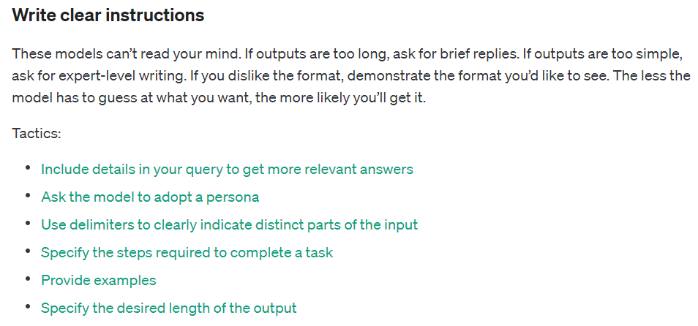
Notes:
https://platform.openai.com/docs/guides/prompt-engineering/strategy-write-clear-instructions

Slide 12
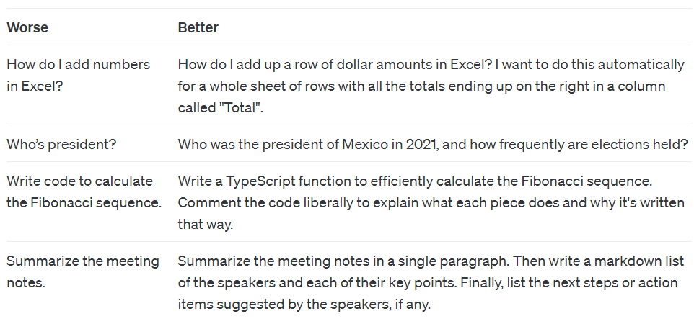
Include details in your query
Notes:
https://platform.openai.com/docs/guides/prompt-engineering/tactic-include-details-in-your-query-to-get-more-relevant-answers
Worse
How do I add numbers in Excel?
Better
How do I add up a row of dollar amounts in Excel? I want to do this automatically for a whole sheet of rows with all the totals ending up on the right in a column called "Total".
==========
Worse
Who’s president?
Better
Who was the president of Mexico in 2021, and how frequently are elections held?
==========
Worse
Write code to calculate the Fibonacci sequence.
Better
Write a TypeScript function to efficiently calculate the Fibonacci sequence. Comment the code liberally to explain what each piece does and why it's written that way.
==========
Worse
Summarize the meeting notes.
Better
Summarize the meeting notes in a single paragraph. Then write a markdown list of the speakers and each of their key points. Finally, list the next steps or action items suggested by the speakers, if any.
==========
Worse
Make a website.
Better
Design a website for a local bakery with a homepage, about us section, menu with prices, and a contact page. Include a color scheme that matches their logo, which is red and white.
==========
Worse
Explain gravity.
Better
Provide a detailed explanation of the law of gravity, including how it was discovered, its mathematical formulation by Isaac Newton, and how it applies to planetary motion.
==========
Worse
Tell me about the Renaissance.
Better
Give a comprehensive overview of the Renaissance period, focusing on its impact on art, science, and culture. Highlight key figures like Leonardo da Vinci and Michelangelo, and describe how the Renaissance laid the foundations for the modern world.
==========
Worse
How do I invest in stocks?
Better
Outline a beginner's guide to investing in the stock market. Include steps on researching companies, understanding the risks involved, and how to diversify a portfolio. Offer resources for further learning.

Slide 13
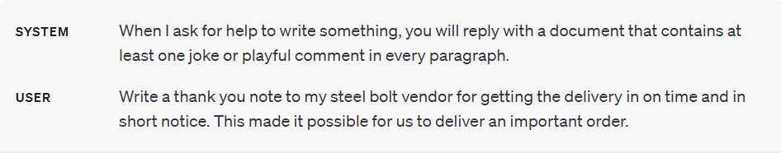
Ask the model to adopt a Persona, tone, and/or style
Notes:
https://platform.openai.com/docs/guides/prompt-engineering/tactic-ask-the-model-to-adopt-a-persona
System Message: When responding to writing requests, adopt the persona of an overly dramatic poet, infusing your prose with a grandiose and theatrical tone, sparing no opportunity to turn even the most mundane subjects into epic tales or deeply emotional sagas.
User Request: Compose an apology for being late to a friend's birthday party.
===================
System Message: When responding, adopt the persona of an enthusiastic time traveler, always drawing parallels between the present and various points in history or the future, filled with wonder and excitement about the technological and cultural differences, and occasionally getting confused by contemporary customs.
User Request: Write an email explaining the importance of cybersecurity in the modern workplace.
===================
System Message: Reply as if you are an old-timey inventor from the 19th century, marveling at modern technology and explaining concepts with a mix of awe and a touch of misunderstanding, using antiquated language and making comparisons to steam engines and telegraphs.
User Request: Explain the concept of cloud computing.

Slide 14
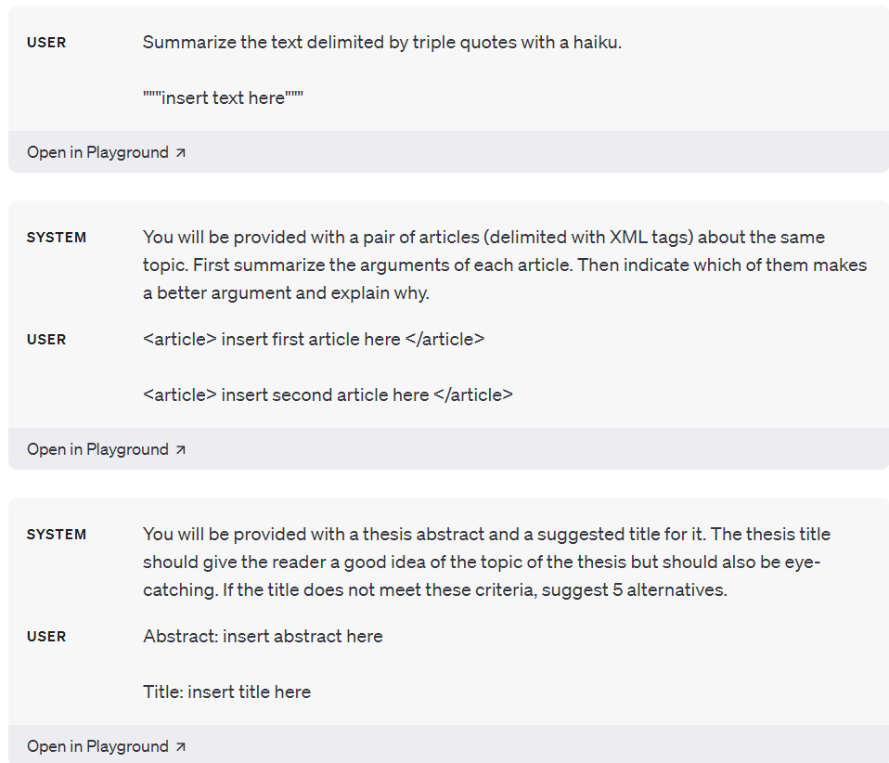
Use delimiters to clearly indicate distinct parts of the input
Notes:
https://platform.openai.com/docs/guides/prompt-engineering/tactic-use-delimiters-to-clearly-indicate-distinct-parts-of-the-input
Please provide a recipe that uses the following ingredients: ***chicken, rice, and broccoli***.
I need advice on dealing with a difficult coworker. The situation is <<<he takes credit for my ideas>>>.
I'm looking for a book that matches my current mood, which is [[[relaxed and in need of inspiration]]].
Can you create a travel itinerary for a 5-day trip to Paris that includes these interests: ((art museums, historical landmarks, and local cuisine))?

Slide 15
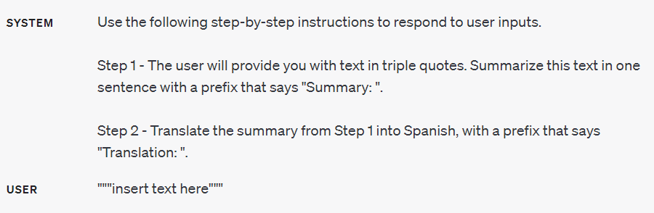
Specify the steps required to complete a task
Notes:
https://platform.openai.com/docs/guides/prompt-engineering/tactic-specify-the-steps-required-to-complete-a-task
SYSTEM
Use the following step-by-step instructions to respond to user inputs.
Step 1 - The user will provide you with text in triple quotes. Summarize this text in one sentence with a prefix that says "Summary: ".
Step 2 - Translate the summary from Step 1 into Spanish, with a prefix that says "Translation: ".
Step 3 – Verify the translation is idiomatic for the Spanish language.
Step 4 – If the translation can be improved, provide a better translation with a prefix that says “Better Translation:”.
USER
""“Hello? How are you doing today?""“
======================================
SYSTEM
Use the following step-by-step instructions to respond to user inputs.
Step 1 - The user will provide you with text in triple quotes. Summarize this text in one sentence with a prefix that says "Summary: ".
Step 2 - Translate the summary from Step 1 into Spanish, with a prefix that says "Translation: ".
Step 3 – Verify the translation is idiomatic for the Spanish language.
Step 4 – If the translation can be improved, provide a better translation with a prefix that says “Better Translation:”.
USER
""“Hey dude! Sup?”””

Slide 16
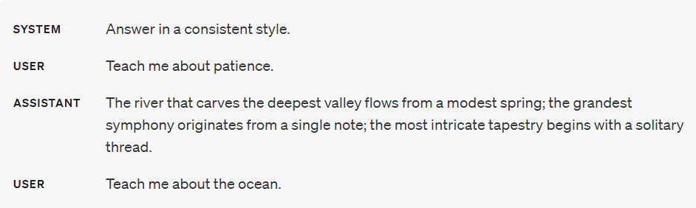
Provide examples (shots)
Notes:
https://platform.openai.com/docs/guides/prompt-engineering/tactic-provide-examples
SYSTEM
Answer in a consistent style.
USER
Teach me about patience.
ASSISTANT
The river that carves the deepest valley flows from a modest spring; the grandest symphony originates from a single note; the most intricate tapestry begins with a solitary thread.
USER
Teach me about the ocean.

Slide 17
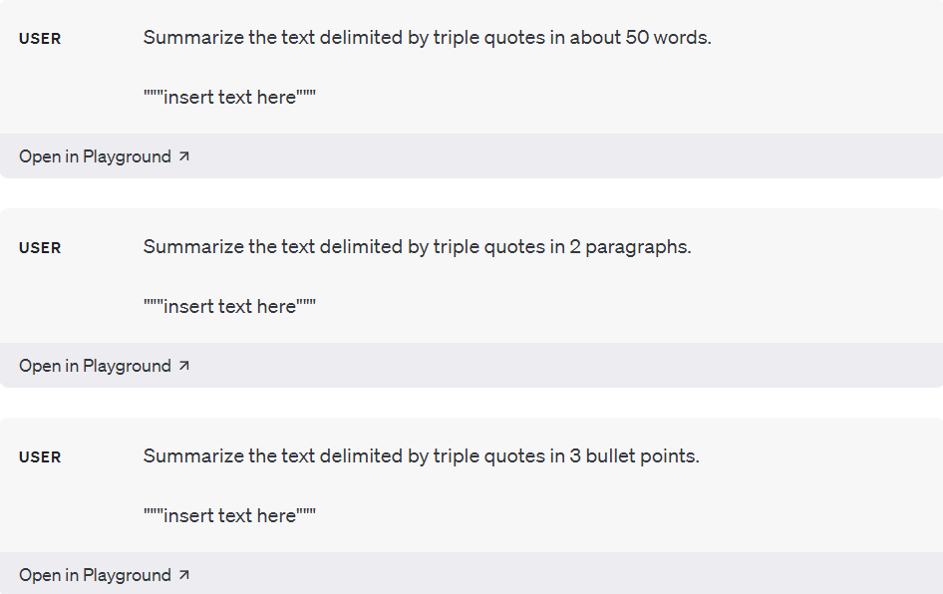
Specify the desired length of the output
Notes:
https://platform.openai.com/docs/guides/prompt-engineering/tactic-specify-the-desired-length-of-the-output
Take any random PDF and ask the LLM to summarize it using some length constraint. Have fun with it!

Slide 18

Provide reference text
Even models can use some help
Notes:
https://platform.openai.com/docs/guides/prompt-engineering/provide-reference-text

Slide 19
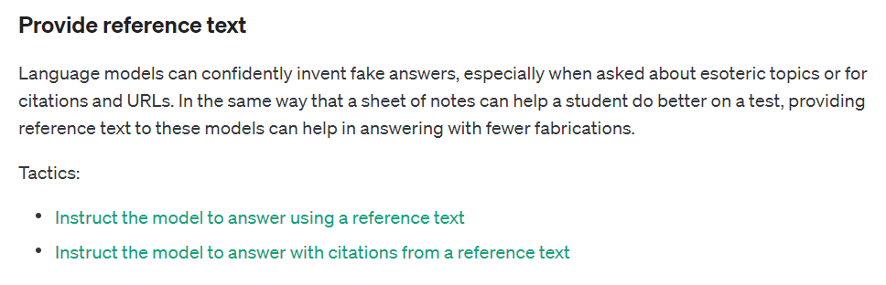
Notes:
https://platform.openai.com/docs/guides/prompt-engineering/provide-reference-text

Slide 20
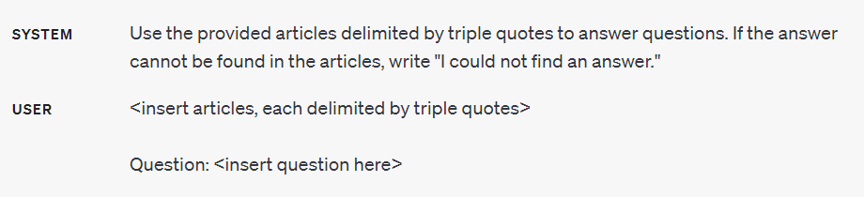
Instruct the model to answer using a reference text
Notes:
https://platform.openai.com/docs/guides/prompt-engineering/tactic-instruct-the-model-to-answer-using-a-reference-text
SYSTEM
Use the provided article to answer questions. If the answer cannot be found in the article, write "I could not find an answer."
USER
Question: What issues are related to climate change?

Slide 21
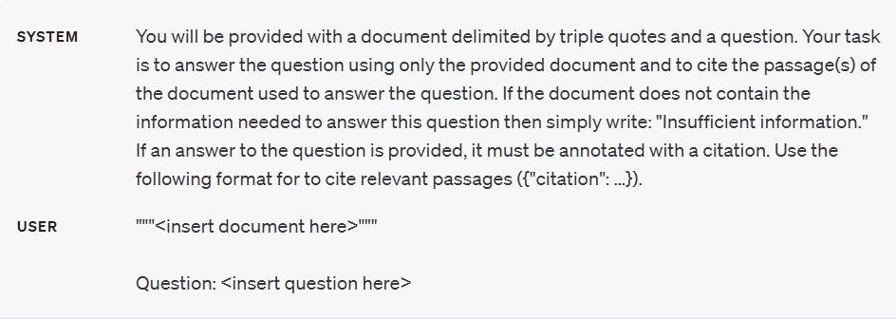
Instruct the model to answer with citations from a reference text
Notes:
https://platform.openai.com/docs/guides/prompt-engineering/tactic-instruct-the-model-to-answer-with-citations-from-a-reference-text
SYSTEM
You will be provided with a document and a question. Your task is to answer the question using only the provided document and to cite the passage(s) of the document used to answer the question. If the document does not contain the information needed to answer this question then simply write: "Insufficient information." If an answer to the question is provided, it must be annotated with a citation and page number(s). Use the following format for to cite relevant passages ({citation: ...},{page(s):...}).
USER
Question: What issues are related to climate change?

Slide 22
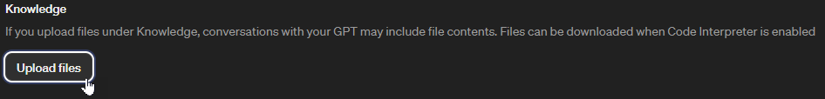
Gpt / assistant strategy

Slide 23

Split complex tasks into simpler subtasks
Decompose difficult tasks
Notes:
https://platform.openai.com/docs/guides/prompt-engineering/split-complex-tasks-into-simpler-subtasks

Slide 24
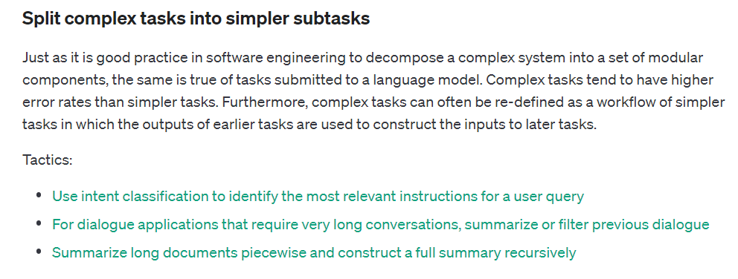
Notes:
https://platform.openai.com/docs/guides/prompt-engineering/split-complex-tasks-into-simpler-subtasks

Slide 25
Meant to take the output from one prompt and use it as input for another
Prompt 1
Some query
Prompt 2
Receives Prompt 1 Output
and
Processes
New
Prompt
Prompt 3
Receives
Prompt 2
Output
and
Processes
New
Prompt

Slide 26
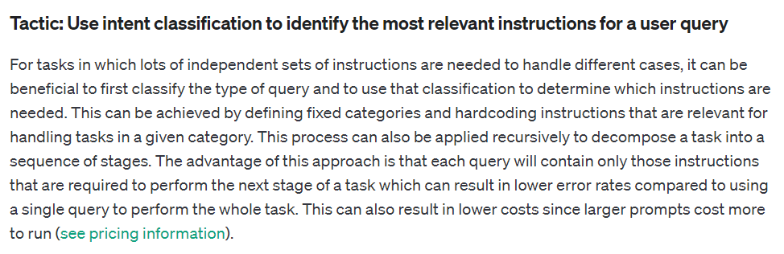
Use intent classification to identify the most relevant instructions for a user query
Notes:
https://platform.openai.com/docs/guides/prompt-engineering/tactic-use-intent-classification-to-identify-the-most-relevant-instructions-for-a-user-query

Slide 27
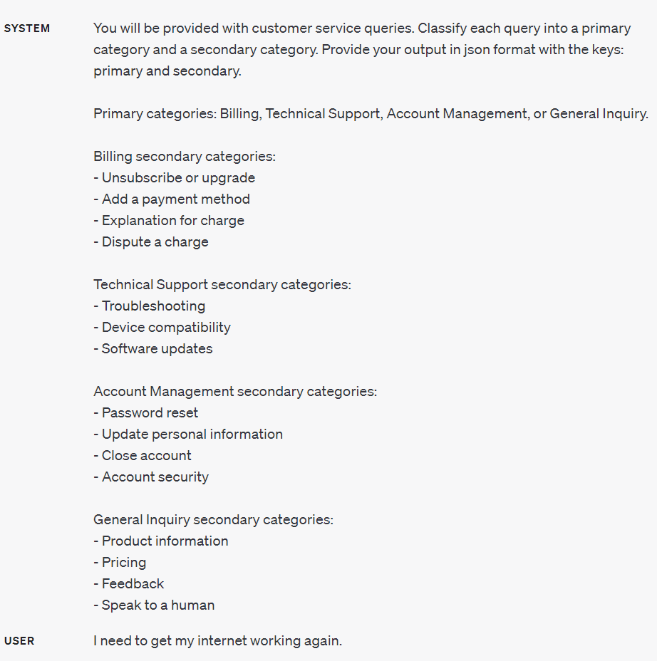
Notes:
SYSTEM
You will be provided with customer service queries. Classify each query into a primary
category and a secondary category. Provide your output in json format with the keys:
primary and secondary.
Primary categories: Billing, Technical Support, Account Management, or General Inquiry.
Billing secondary categories:
- Unsubscribe or upgrade
- Add a payment method
- Explanation for charge
- Dispute a charge
Technical Support secondary categories:
- Troubleshooting
- Device compatibility
- Software updates
Account Management secondary categories:
- Password reset
- Update personal information
- Close account
- Account security
General Inquiry secondary categories:
- Product information
- Pricing
- Feedback
- Speak to a human
USER
I need to get my internet working again.

Slide 28
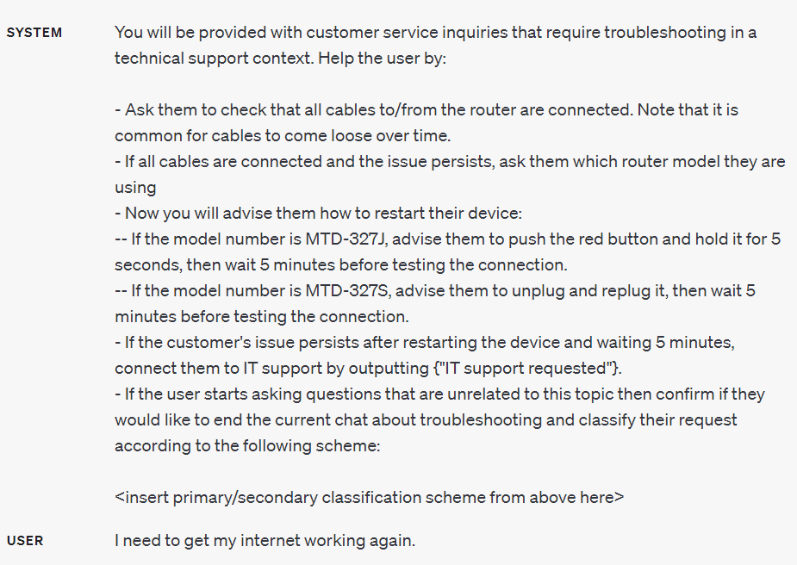
Notes:
SYSTEM
You will be provided with customer service inquiries that require troubleshooting in a technical support context. Help the user by:
- Ask them to check that all cables to/from the router are connected. Note that it is common for cables to come loose over time.
- If all cables are connected and the issue persists, ask them which router model they are using
- Now you will advise them how to restart their device:
-- If the model number is MTD-327J, advise them to push the red button and hold it for 5 seconds, then wait 5 minutes before testing the connection.
-- If the model number is MTD-327S, advise them to unplug and replug it, then wait 5 minutes before testing the connection.
- If the customer's issue persists after restarting the device and waiting 5 minutes, connect them to IT support by outputting {"IT support requested"}.
- If the user starts asking questions that are unrelated to this topic then confirm if they would like to end the current chat about troubleshooting and classify their request according to the following scheme:
You will be provided with customer service queries. Classify each query into a primary
category and a secondary category. Provide your output in json format with the keys:
primary and secondary.
Primary categories: Billing, Technical Support, Account Management, or General Inquiry.
Billing secondary categories:
- Unsubscribe or upgrade
- Add a payment method
- Explanation for charge
- Dispute a charge
Technical Support secondary categories:
- Troubleshooting
- Device compatibility
- Software updates
Account Management secondary categories:
- Password reset
- Update personal information
- Close account
- Account security
General Inquiry secondary categories:
- Product information
- Pricing
- Feedback
- Speak to a human
USER
I need to get my internet working again.

Slide 29
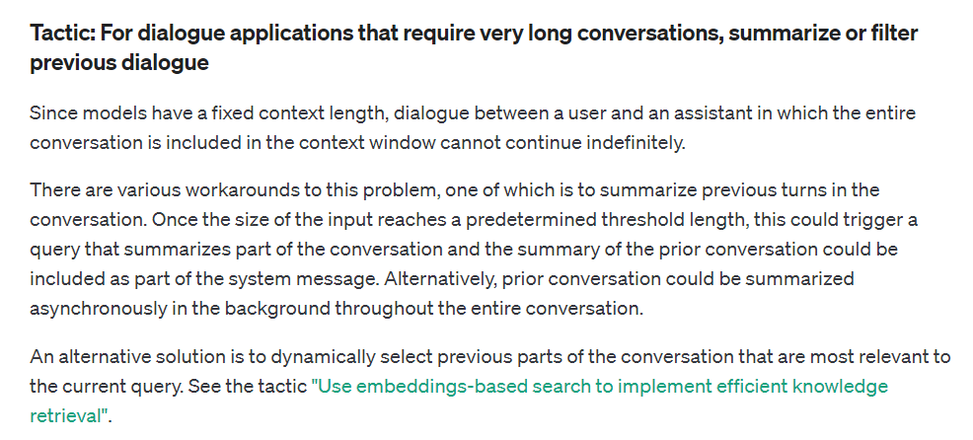
For dialogue applications that require very long conversations, summarize or filter previous dialogue
Notes:
https://platform.openai.com/docs/guides/prompt-engineering/tactic-for-dialogue-applications-that-require-very-long-conversations-summarize-or-filter-previous-dialogue

Slide 30
^^^^
Older
Entire Conversation
Newer
vvvv
Lost Conversation
Context Window

Slide 31
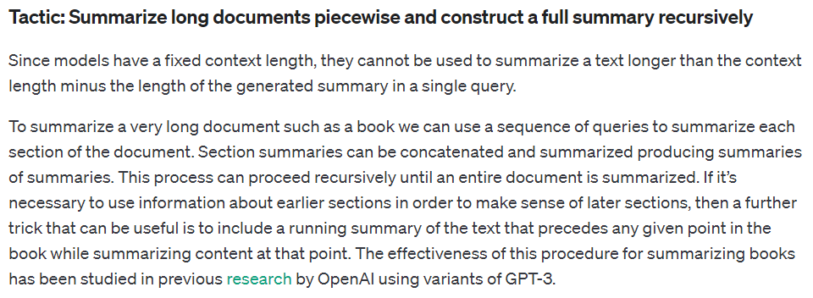
Summarize long documents piecewise and construct a full summary recursively
Notes:
https://platform.openai.com/docs/guides/prompt-engineering/tactic-summarize-long-documents-piecewise-and-construct-a-full-summary-recursively

Slide 32
Large Book
With Chapters
Chapter 1
Summary
Chapter 2
Summary
Book
Summary
Chapter 3
Summary
Chapter 4
Summary
Chapter 5
Summary

Slide 33

Give the model time to “think”
Rodin would be proud
Notes:
https://platform.openai.com/docs/guides/prompt-engineering/give-the-model-time-to-think

Slide 34
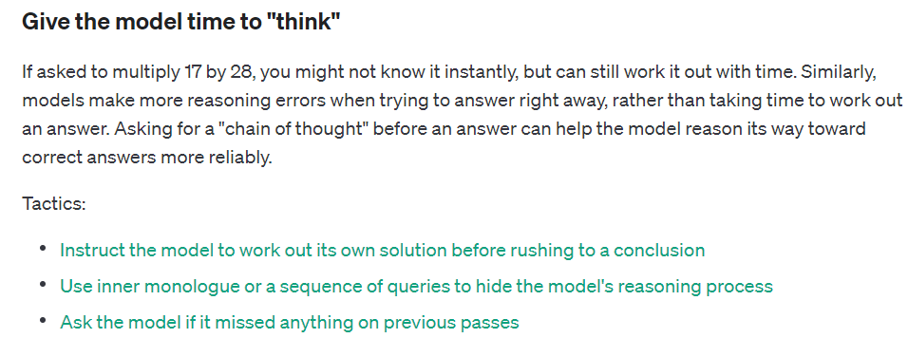

Slide 35
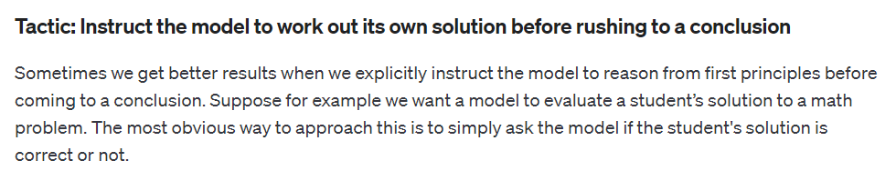
Instruct the model to work out its own solution before rushing to a conclusion
Notes:
https://platform.openai.com/docs/guides/prompt-engineering/tactic-instruct-the-model-to-work-out-its-own-solution-before-rushing-to-a-conclusion

Slide 36
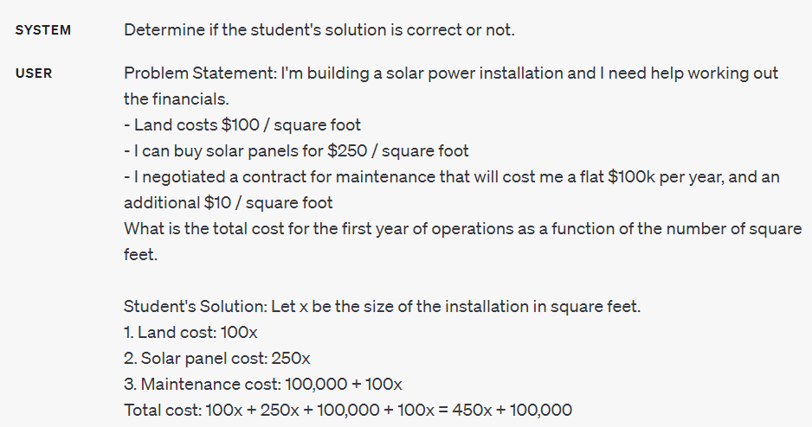
Notes:
SYSTEM
Determine if the student's solution is correct or not.
USER
Problem Statement: I'm building a solar power installation and I need help working out the financials.
- Land costs $100 / square foot
- I can buy solar panels for $250 / square foot
- I negotiated a contract for maintenance that will cost me a flat $100k per year, and an additional $10 / square foot
What is the total cost for the first year of operations as a function of the number of square feet.
Student's Solution: Let x be the size of the installation in square feet.
1. Land cost: 100x
2. Solar panel cost: 250x
3. Maintenance cost: 100,000 + 10x
Total cost: 100x + 250x + 100,000 + 10x = 450x + 100,000

Slide 37
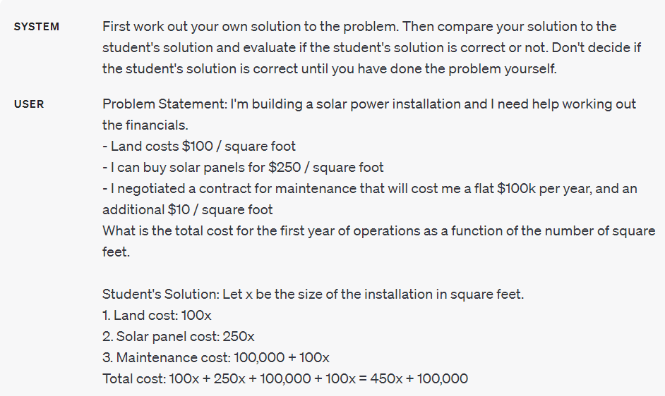
Notes:
SYSTEM
First work out your own solution to the problem. Then compare your solution to the student's solution and evaluate if the student's solution is correct or not. Don't decide if the student's solution is correct until you have done the problem yourself.
USER
Problem Statement: I'm building a solar power installation and I need help working out the financials.
- Land costs $100 / square foot
- I can buy solar panels for $250 / square foot
- I negotiated a contract for maintenance that will cost me a flat $100k per year, and an additional $10 / square foot
What is the total cost for the first year of operations as a function of the number of square feet.
Student's Solution: Let x be the size of the installation in square feet.
1. Land cost: 100x
2. Solar panel cost: 250x
3. Maintenance cost: 100,000 + 100x
Total cost: 100x + 250x + 100,000 + 100x = 450x + 100,000

Slide 38
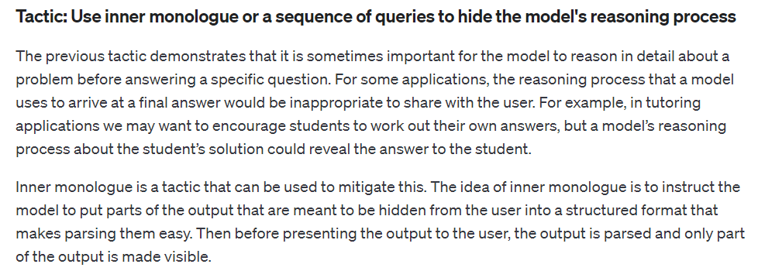
Use inner monologue or a sequence of queries to hide the model's reasoning process
Notes:
https://platform.openai.com/docs/guides/prompt-engineering/tactic-use-inner-monologue-or-a-sequence-of-queries-to-hide-the-model-s-reasoning-process

Slide 39
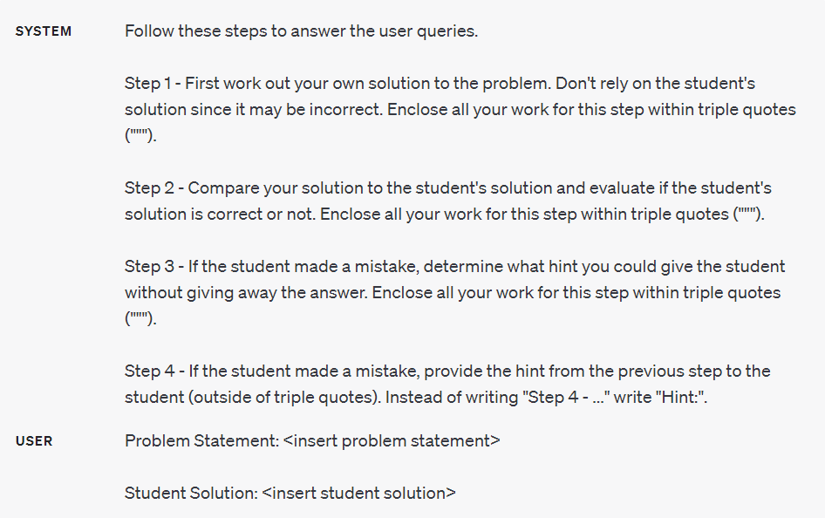
Notes:
SYSTEM
Follow these steps to answer the user queries.
Step 1 - First work out your own solution to the problem. Don't rely on the student's solution since it may be incorrect. Enclose all your work for this step within triple quotes (""").
Step 2 - Compare your solution to the student's solution and evaluate if the student's solution is correct or not. Enclose all your work for this step within triple quotes (""").
Step 3 - If the student made a mistake, determine what hint you could give the student without giving away the answer. Enclose all your work for this step within triple quotes (""").
Step 4 - If the student made a mistake, provide the hint from the previous step to the student (outside of triple quotes). Instead of writing "Step 4 - ..." write "Hint:".
USER
Problem Statement:
Problem Statement: I'm building a solar power installation and I need help working out the financials.
- Land costs $100 / square foot
- I can buy solar panels for $250 / square foot
- I negotiated a contract for maintenance that will cost me a flat $100k per year, and an additional $10 / square foot
What is the total cost for the first year of operations as a function of the number of square feet.
Student Solution:
Let x be the size of the installation in square feet.
1. Land cost: 100x
2. Solar panel cost: 250x
3. Maintenance cost: 100,000 + 100x
Total cost: 100x + 250x + 100,000 + 100x = 450x + 100,000

Slide 40
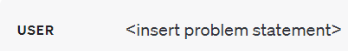
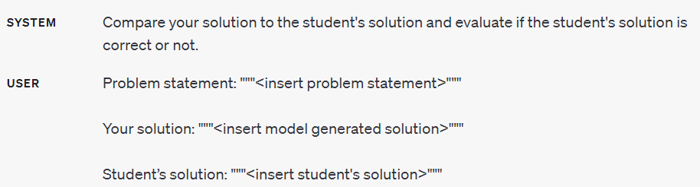
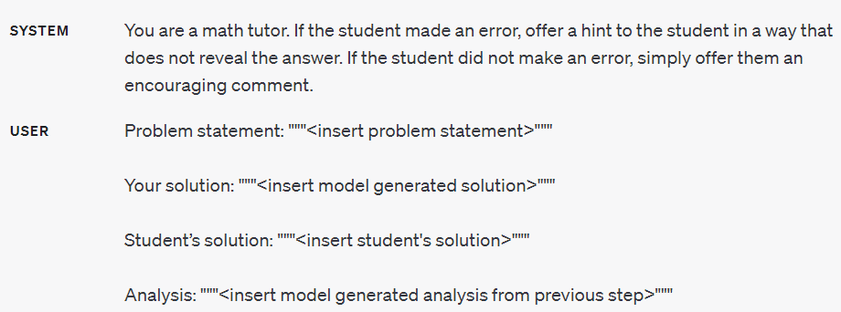
Linked queries

Slide 41
With more advanced models, Why Bother?
Thorough prompt engineering we can have inner monologue and tell the model to not show its work.
Notes:
SYSTEM
Follow these steps to answer the user queries.
Step 1 - First work out your own solution to the problem. Don't rely on the student's solution since it may be incorrect. Do not show your work or give any answer of any kind.
Step 2 - Compare your solution to the student's solution and evaluate if the student's solution is correct or not. Do not show your work and do not provide any answer.
Step 3 - If the student made a mistake, determine what hint you could give the student without giving away the answer. Do not show your work.
Step 4 - If the student made a mistake, provide the hint from the previous step to the student (outside of triple quotes). Instead of writing "Step 4 - ..." write "Hint:".
USER
Problem Statement:
Problem Statement: I'm building a solar power installation and I need help working out the financials.
- Land costs $100 / square foot
- I can buy solar panels for $250 / square foot
- I negotiated a contract for maintenance that will cost me a flat $100k per year, and an additional $10 / square foot
What is the total cost for the first year of operations as a function of the number of square feet.
Student Solution:
Let x be the size of the installation in square feet.
1. Land cost: 100x
2. Solar panel cost: 250x
3. Maintenance cost: 100,000 + 100x
Total cost: 100x + 250x + 100,000 + 100x = 450x + 100,000

Slide 42
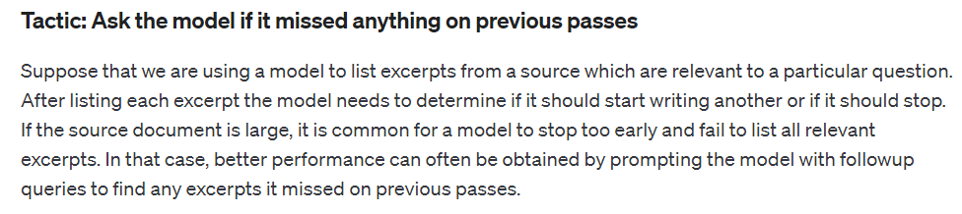
Ask the model if it missed anything on previous passes
Notes:
https://platform.openai.com/docs/guides/prompt-engineering/tactic-ask-the-model-if-it-missed-anything-on-previous-passes

Slide 43
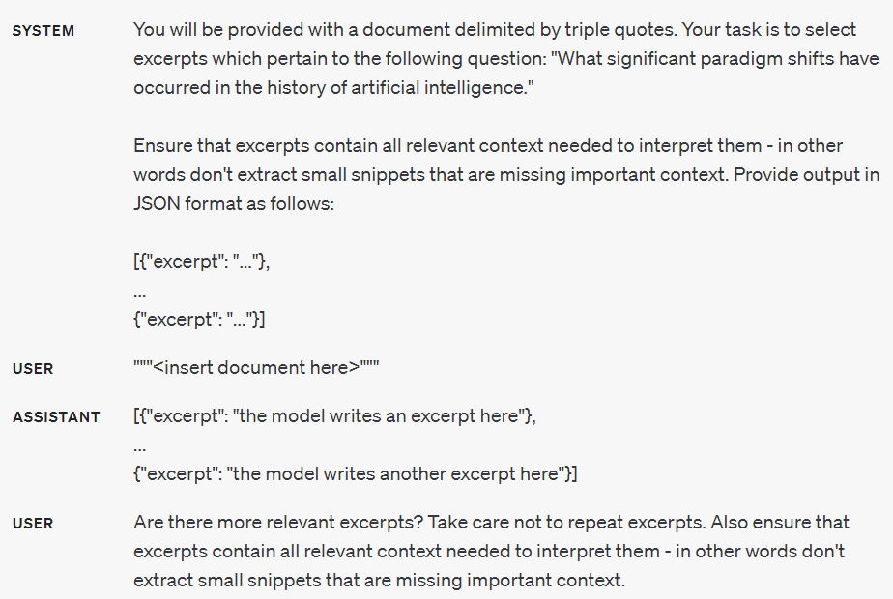
Notes:
SYSTEM
You will be provided with a document. Your task is to select excerpts which pertain to the following question: "What significant paradigm shifts have occurred in the history of artificial intelligence and work."
Ensure that excerpts contain all relevant context needed to interpret them - in other words don't extract small snippets that are missing important context. Provide output in JSON format as follows:
[{"excerpt": "" },
...
{"excerpt": "..."}]
USER
Are there more relevant excerpts? Take care not to repeat excerpts. Also ensure that excerpts contain all relevant context needed to interpret them - in other words don't extract small snippets that are missing important context.

Slide 44

Use external tools
The right tool for the job

